Slide 1
Adaptive Noise cancellation
Least Mean Square
(LMS)
Normalized LMS (NLMS)
Fast Block LMS

Slide 2
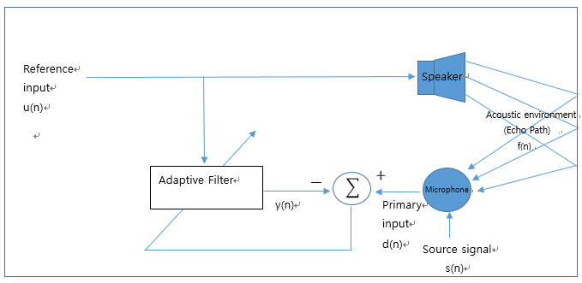
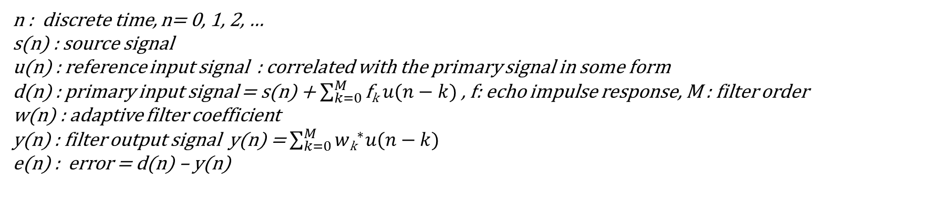
Interference Noise cancellation
n : discrete time, n= 0, 1, 2, …
s(n) : source signal
u(n) : reference input signal : correlated with the primary signal in some form
d(n) : primary input signal = s(n) + $\sum_{k=0}^{M}{\text{f}\text{k}{ u(n−k)}^{ }}$, f: echo impulse response, M : filter order
w(n) : adaptive filter coefficient
y(n) : filter output signal y(n) = $\sum_{k=0}^{M}{{w\text{k}}^{∗}{u(n−k)}^{ }}$
e(n) : error = d(n) – y(n)

Slide 3

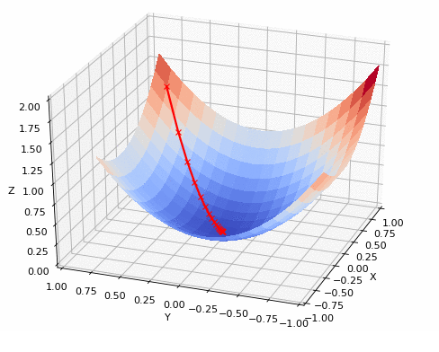
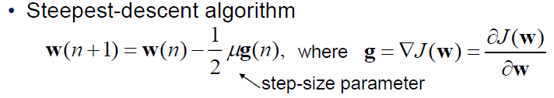
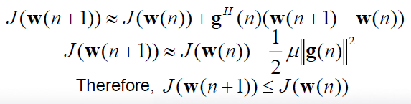
Steepest Descent Method
임의의 함수의 최적해를 구하는 방법으로 함수의 기울기(Gradient)를 구하여 Gradient의 반대 방향으로 반복적으로
update하여 local optimum solution을 찾을 수 있다.
- (1)
(1)의 조건에서 w은 아래와 같이 update 된다.
★ pf. -(1) First-order Taylor series expansion
Minimum Point of error performance surface

Slide 4
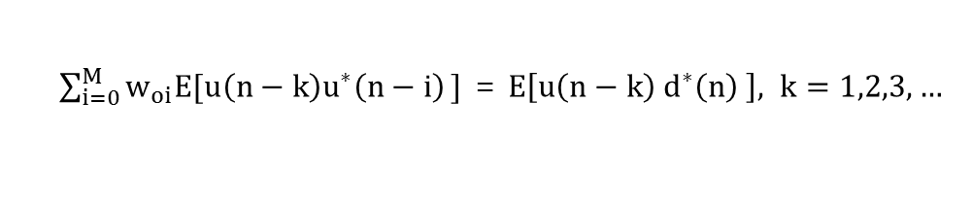
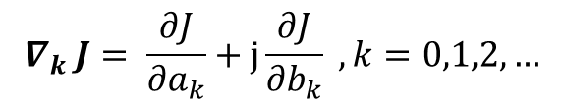
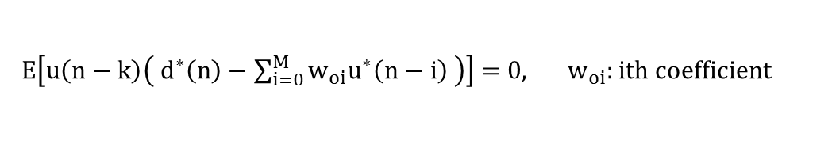
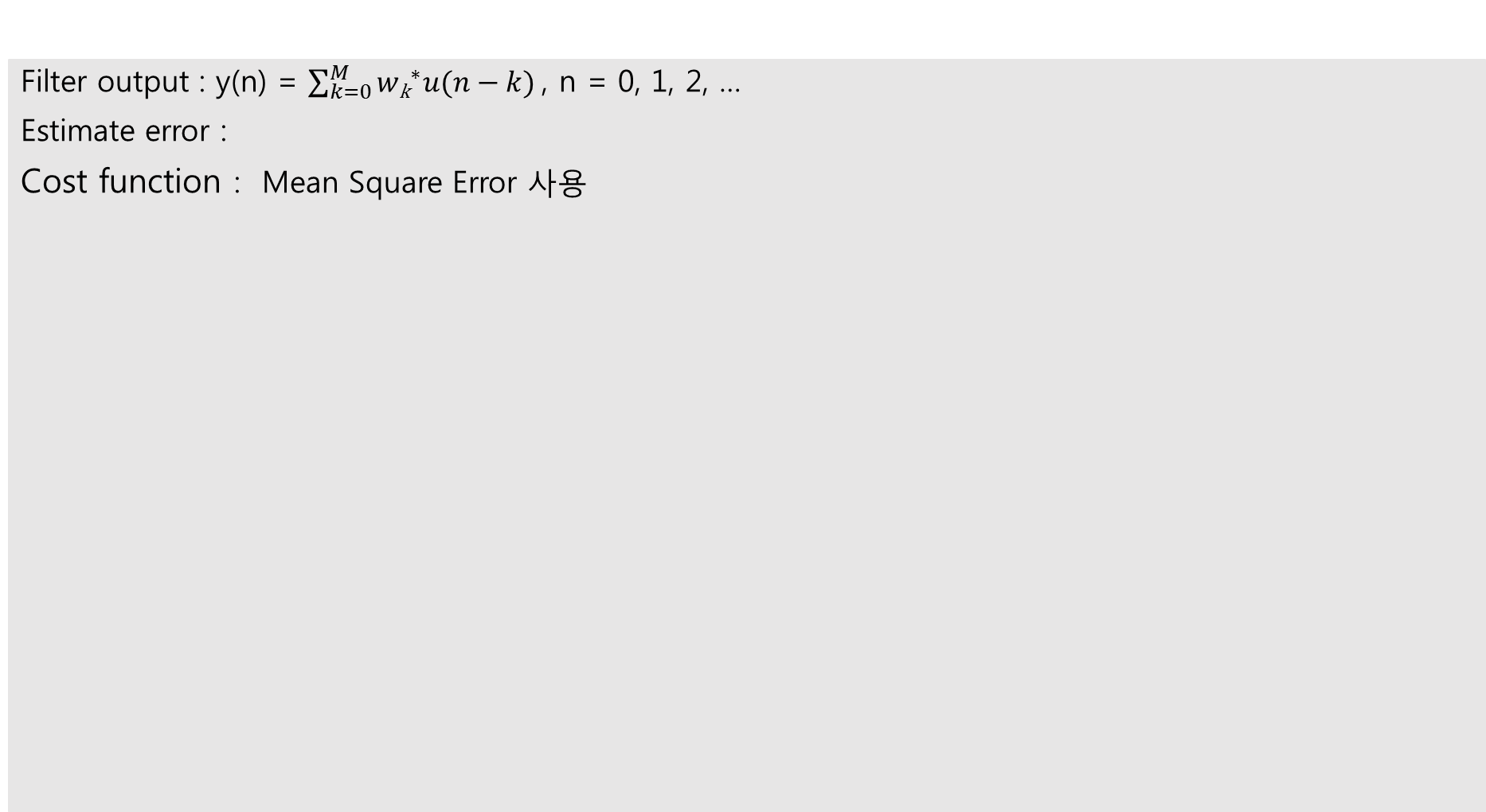


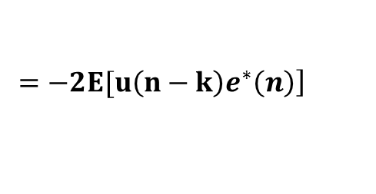
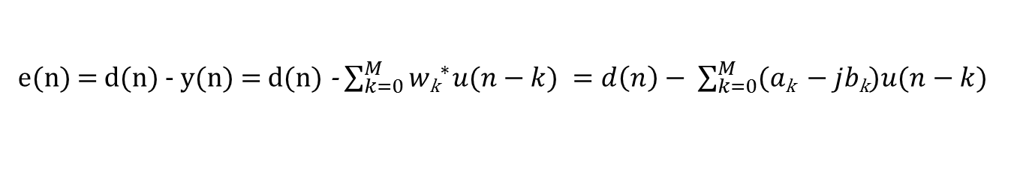
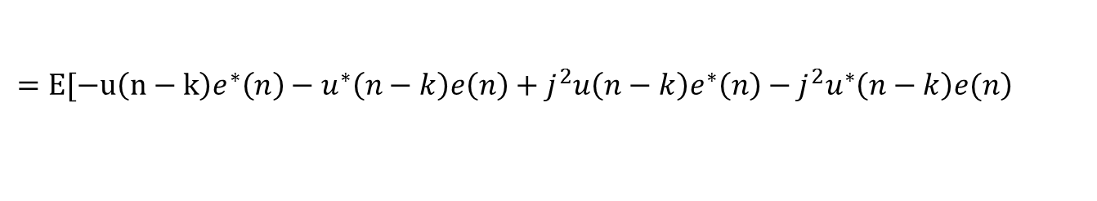
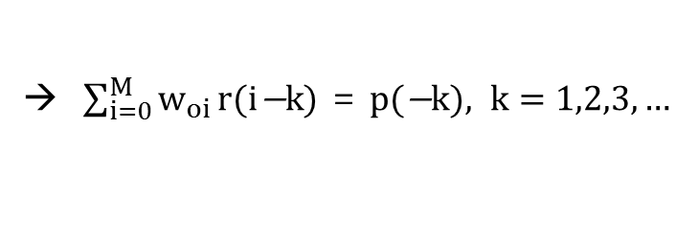
Principle of Orthogonality
Filter output : y(n) = $\sum_{k=0}^{M}{{w\text{k}}^{∗}{u(n−k)}^{ }}$, n = 0, 1, 2, …
Estimate error :
Cost function : Mean Square Error 사용
${where w}_{k}$ : $a_{k}+jb_{k}$, Complex gradient vector.
e(n) = d(n) - y(n) = d(n) - $\sum_{k=0}^{M}{{w\text{k}}^{∗}{u(n−k)}^{ }}=d\left(n\right)− \sum_{k=0}^{M}{({a\text{k}}^{ }−jb\text{k}{)u(n−k)}^{ }}$
$$J=E\left[e\left(n\right)e^{∗}\left(n\right)\right]=E\left[{\left|e\left(n\right)\right|}^{2}\right], J \text{ :} \text{Continuously} \text{differentiable} \text{function}$$
$$\text{→} \text{J}\text{를} { w}_{k}로 \text{미분하여} \text{optimal} \text{value}\text{를} \text{찾는다}$$
$$∇_{k} J= \frac{∂J}{{∂a}_{k}}+j\frac{∂J}{{∂b}_{k}} , k=0,1,2,…$$
$$=E\left[\frac{\left.∂[e\left(n\right)e^{∗}\left(n\right)\right]}{{∂a}_{k}}+\frac{\left.∂[e\left(n\right)e^{∗}\left(n\right)\right]}{{∂b}_{k}} \right]=E[\frac{∂e\left(n\right)}{{∂a}_{k}}e^{∗}\left(n\right)+\frac{∂e^{∗}\left(n\right)}{{∂b}_{k}}e\left(n\right)+j\frac{∂e\left(n\right)}{{∂b}_{k}}e^{∗}\left(n\right)+j\frac{∂e^{∗}\left(n\right)}{{∂b}_{k}}e\left(n\right)$$
$$\left.=E[−u\left(n−k\right)e^{∗}\left(n\right)−u^{∗}\left(n−k\right)e\left(n\right)+j^{2}u\left(n−k\right)e^{∗}\left(n\right)−j^{2}u^{∗}\left(n−k\right)e(n\right)$$
$$\left.=−2E[u\left(n−k\right)e^{∗}\left(n\right)\right]$$
$$∴w\left(n+1\right)=w\left(n\right)+μE[u\left(n−k\right)e^{∗}\left(n\right)]$$
$$optimum condition :∇_{k} J=E[u\left(n−k\right){e_{o}}^{∗}\left(n\right) ] \text{= 0}$$
Wiener-Hopf equaitons
$E\left[u\left(n−k\right)\left({ d}^{∗}\left(n\right)−\sum_{i=0}^{M}{w_{oi}u^{∗}\left(n−i\right)} \right)\right] \text{= 0}\text{, } w_{oi}:ith coefficient$
→ $\sum_{i=0}^{M}{w_{oi}}\text{r}\text{(}\text{i}\text{−}\text{k}\text{)} \text{=} \text{p}\text{(}\text{−}\text{k}\text{)}, k=1,2,3,…$
$\sum_{i=0}^{M}{w_{oi}E[u\left(n−k\right)u^{∗}\left(n−i\right)}\text{]} \text{=} E\left[u\left(n−k\right){ d}^{∗}\left(n\right) \right], k=1,2,3,…$

Slide 5
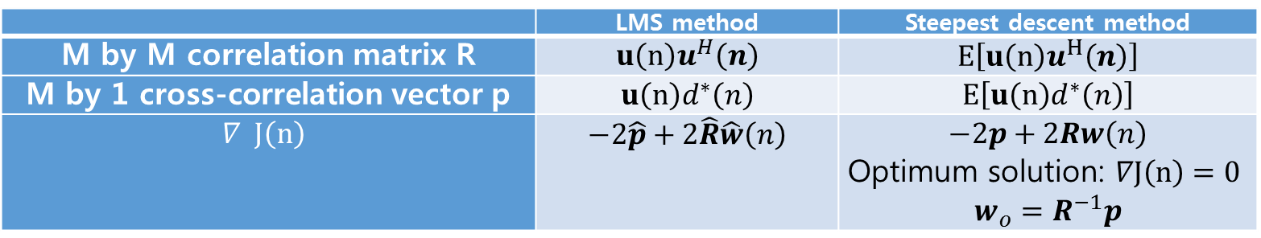
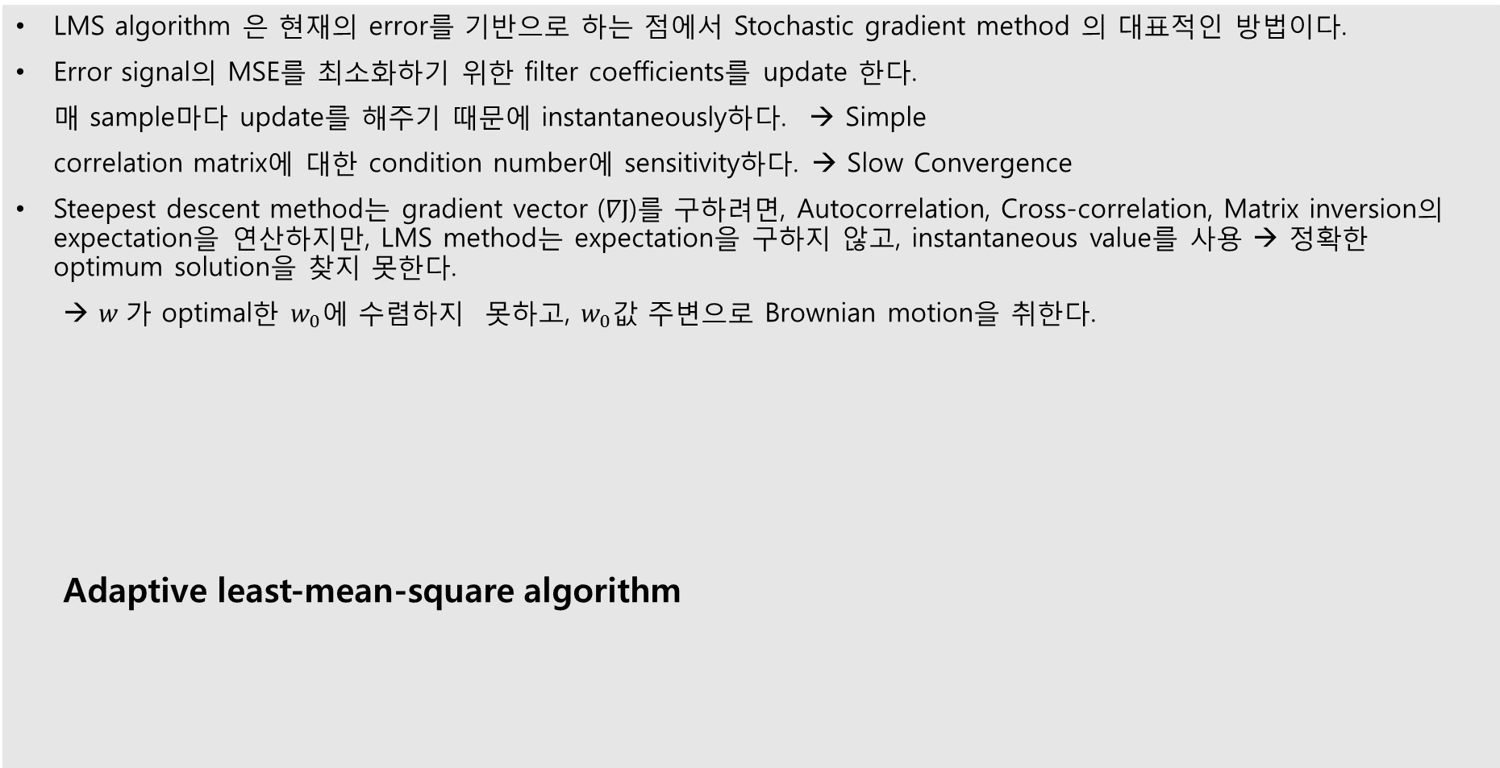
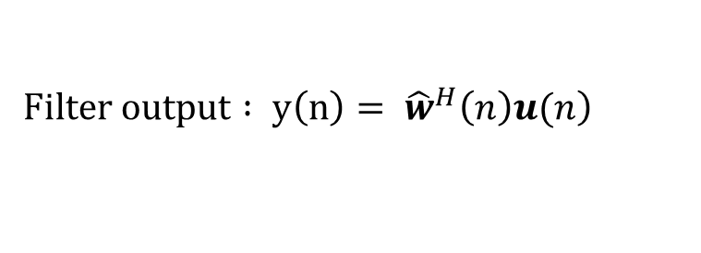
Least Mean Square Adaptive Filter
LMS algorithm 은 현재의 error를 기반으로 하는 점에서 Stochastic gradient method 의 대표적인 방법이다.
Error signal의 MSE를 최소화하기 위한 filter coefficients를 update 한다.
매 sample마다 update를 해주기 때문에 instantaneously하다. → Simple
correlation matrix에 대한 condition number에 sensitivity하다. → Slow Convergence
Steepest descent method는 gradient vector ($∇J$)를 구하려면, Autocorrelation, Cross-correlation, Matrix inversion의 expectation을 연산하지만, LMS method는 expectation을 구하지 않고, instantaneous value를 사용 → 정확한 optimum solution을 찾지 못한다.
→ $w$가 optimal한 $w_{0}에$ 수렴하지 못하고, $w_{0}값$ 주변으로 Brownian motion을 취한다.
Adaptive least-mean-square algorithm
 | LMS method | Steepest descent method
M by M correlation matrix R | $$u\left(n\right)u^{H}\left(n\right)$$ | $$E\left[u\left(n\right)u^{H}\left(n\right)\right]$$
M by 1 cross-correlation vector p | $$u\left(n\right)d^{∗}\left(n\right)$$ | $$E\left[u\left(n\right)d^{∗}\left(n\right)\right]$$
$$∇ J\left(n\right)$$ | $$−2\hat{p}+2\hat{R}\hat{w}\left(n\right)$$ | $$−2p+2Rw\left(n\right)$$ Optimum solution: $∇J\left(n\right)=0$ $$w_{o}=R^{−1}p$$
$$\left.Filter output : y\left(n\right)= {\hat{w}}^{H}\left(n\right)u(n\right)$$
$$Tap−weight adaptation : \hat{w}\left(n+1\right)=\hat{w}\left(n\right)+μu\left(n\right)e^{∗}\left(n\right)$$

Slide 6
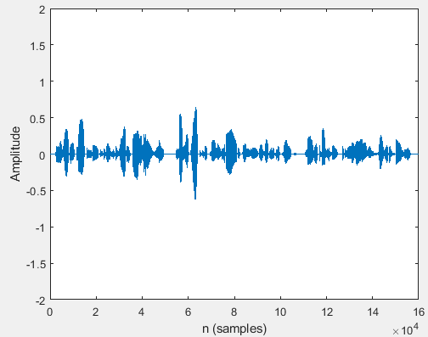
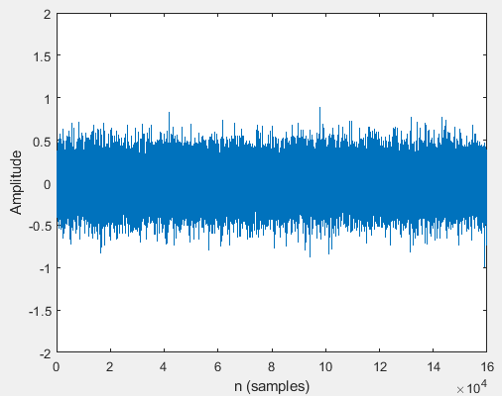
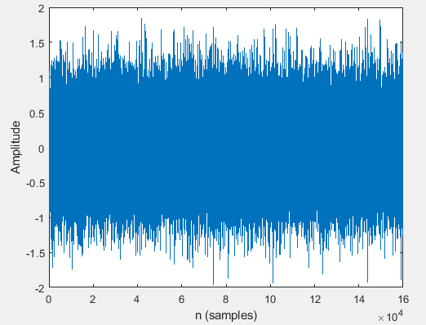
Least Mean Square Adaptive Filter
문제 1
문제 1.
Signal source s(n)으로 "FSJK1_con_160000_mul5.wav", noise source u(n)으로 "laplacian1.wav", f으로 [-0.4 -1.7 0.1 0.3 -1.1 1.2 1.2 0.0 0.3 0.2]를 사용하여 LMS algorithm을 구현하라.
e(n), e(n)-s(n)의 waveform을 그리고, f와 최종 w를 비교하라.
Fig .1-1
(a) Signal source s(n) (b)Reference input u(n) (c) Primary input d(n)

Slide 7
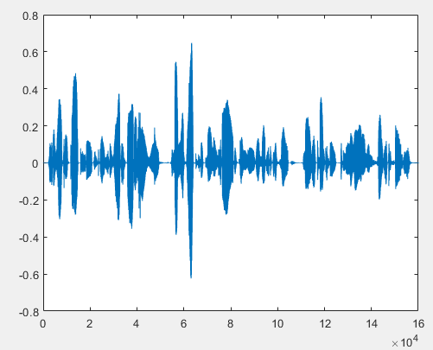
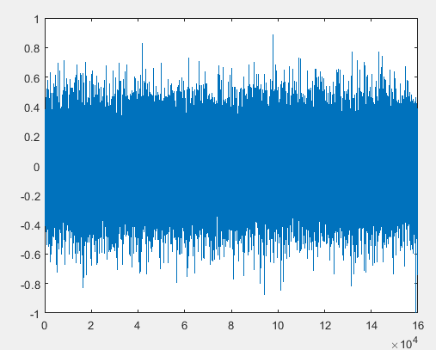
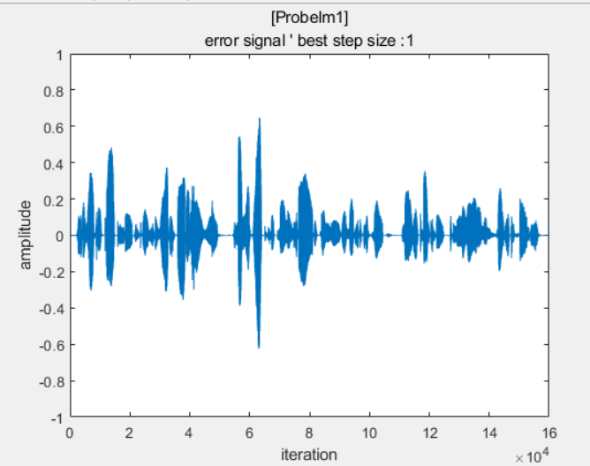
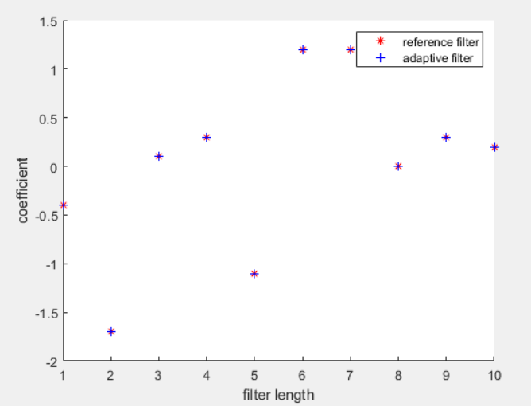
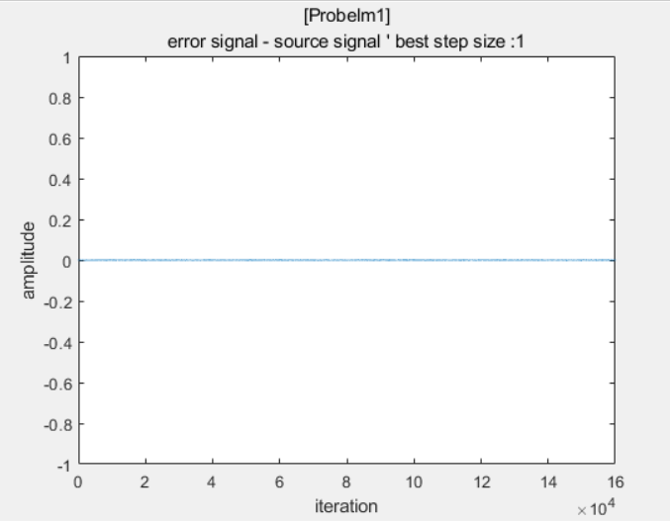
Least Mean Square Adaptive Filter
문제 1
1. LMS algorithm 구현.
f = [-0.4 -1.7 0.1 0.3 -1.1 1.2 1.2 0.0 0.3 0.2] step size µ = 1
Signal source s(n)
Noise source u(n)
Fig .1-2 (u(n) gaussian white noise , µ : 1)
(a) Error signal(e(n), e(n)-s(n) for filter order 10 (b) Compare Filter coefficients for filter order 10

Slide 8
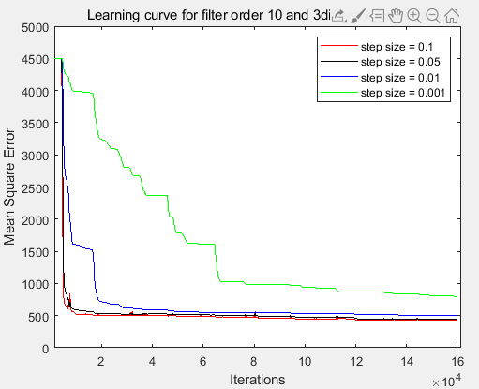
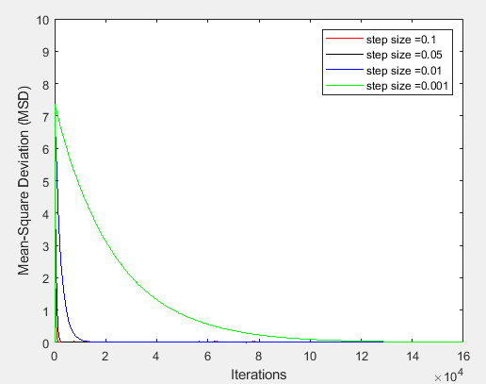
Least Mean Square Adaptive Filter
문제 1
Fig .1-3 (u(n) gaussian white noise , µ : 0.05)
Performance Measure of LMS filter order 10 Convergence parameter
(a) Mean square value of the error signal (MSE) (b) Mean Square Deviation of the Tap weight vector

Slide 9
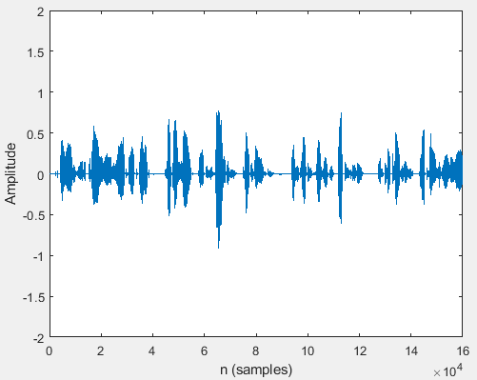
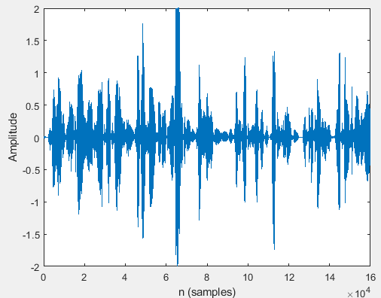
Least Mean Square Adaptive Filter
문제 2
문제 2.
Noise source u(n)을 "MDAC0_con_160000_mul5.wav"로 바꾼 후 e(n), e(n)-s(n)의 waveform을 그리고, f와 최종 w를 비교하라.
Fig .2-1
(a) Signal source s(n) (b)Reference input u(n) (c) Primary input d(n)

Slide 10
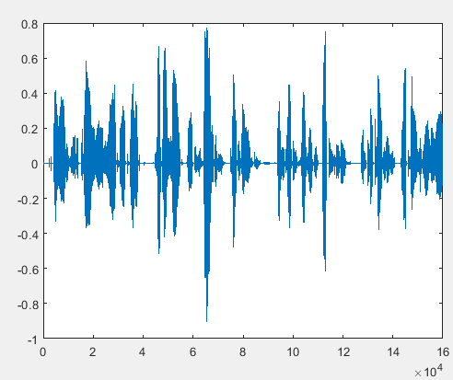
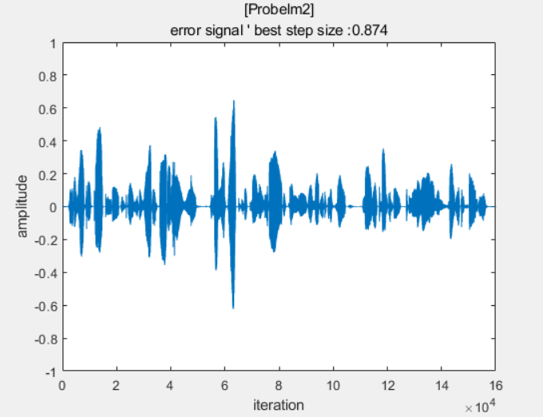
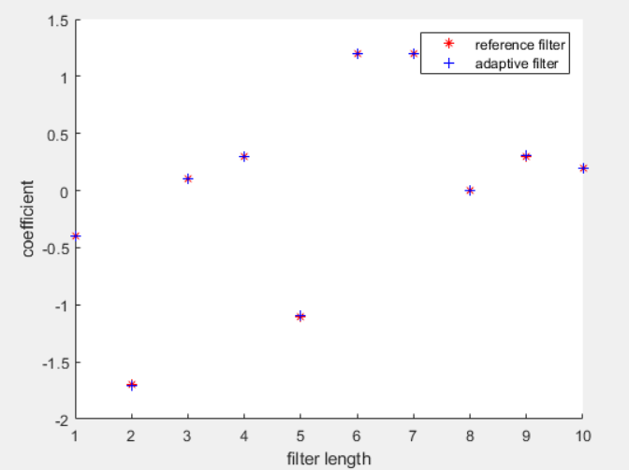
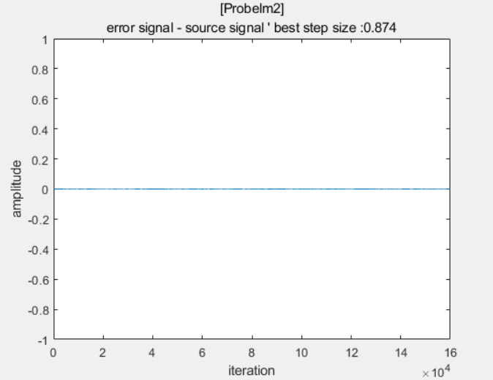
Least Mean Square Adaptive Filter
문제 2
1. LMS algorithm 구현.
f = [-0.4 -1.7 0.1 0.3 -1.1 1.2 1.2 0.0 0.3 0.2] step size µ = 0.874
Signal source s(n)
Noise source u(n)
Fig .2-2 (u(n) : voice signal noise, µ : 0.874)
(a) Error signal(e(n), e(n)-s(n) for filter order 10 (b) Compare Filter coefficients for filter order 10

Slide 11
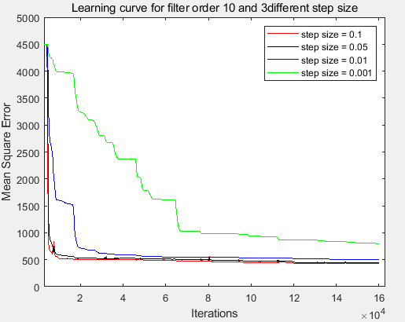
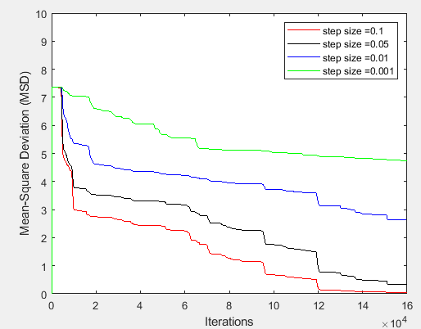
Least Mean Square Adaptive Filter
문제 2
Fig .2-3 (u(n) : voice signal noise, µ : 0.05)
Performance Measure of LMS filter order 10 Convergence parameter
(a) Mean square value of the error signal (MSE) (b) Mean Square Deviation of the Tap weight vector

Slide 12
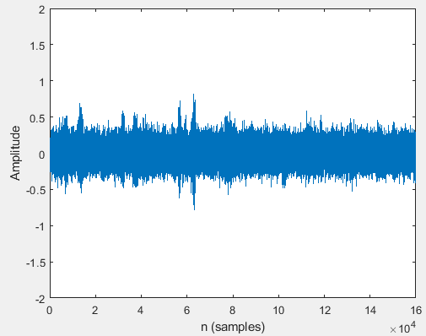
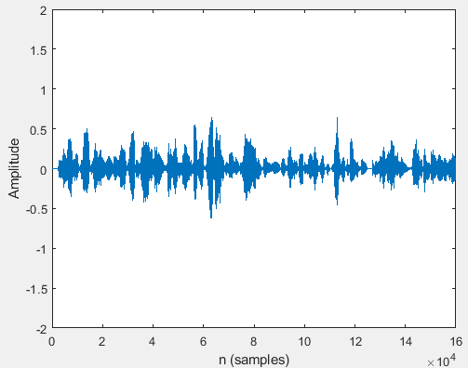
Least Mean Square Adaptive Filter
문제 3
문제 3.
f를 "standp4m1_nhpf_512.wav"로 바꾸고 1,2번 실험을 반복하라. 3번의 1,2번 결과를 비교하고, 위 1, 2번과도 비교하라.
Fig .3-1
(a) Signal source s(n) (b)Reference input u(n) (c) Primary input d(n)

Slide 13
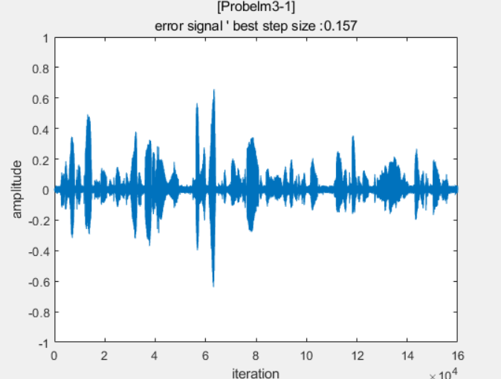
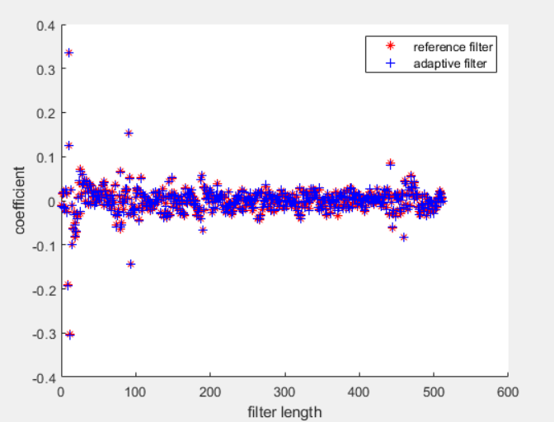
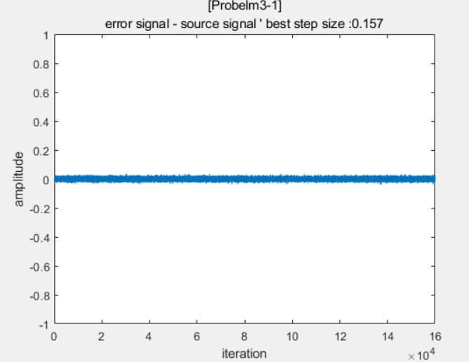
Least Mean Square Adaptive Filter
문제 3
1. LMS algorithm 구현.
f = “standp4m1_nhpf_512.wav” step size µ = 0.157
Signal source s(n)
Noise source u(n)
Fig .3-2 (u(n) : gaussian white noise , µ : 0.157)
(a) Error signal(e(n), e(n)-s(n) for filter order 512 (b) Compare Filter coefficients for filter order 512

Slide 14
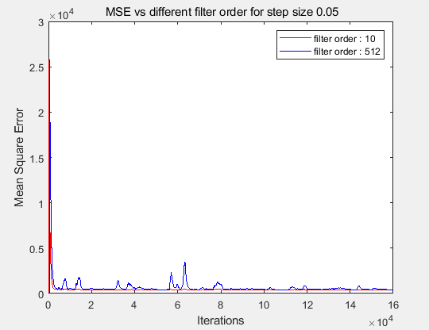
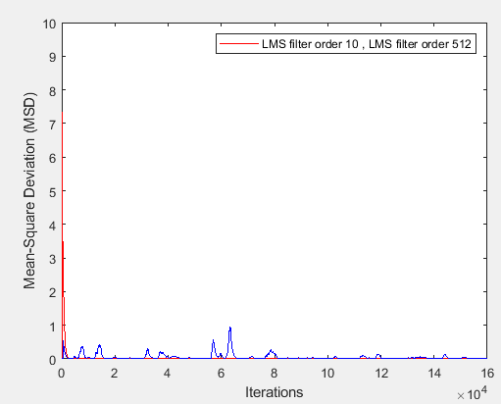
Least Mean Square Adaptive Filter
문제 3 (cf. 문제 1)
Fig .3-3 (u(n) : gaussian white noise , µ : 0.05)
Performance Measure of LMS filter order 10, filter order 512 Convergence parameter
(a) Mean square value of the error signal (MSE) (b) Mean Square Deviation of the Tap weight vector

Slide 15
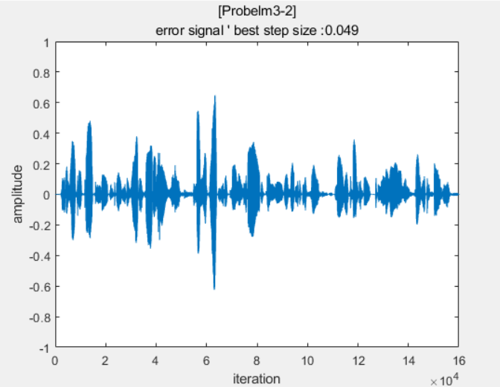
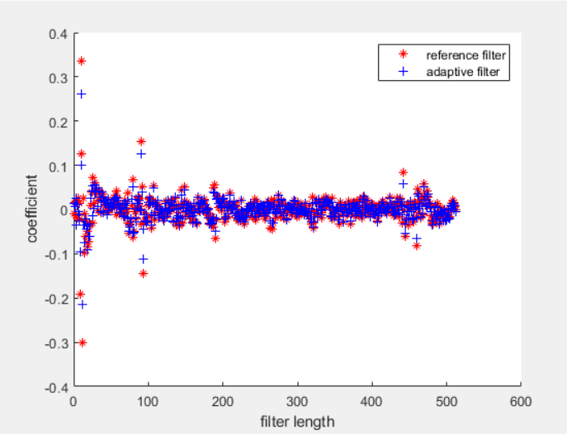
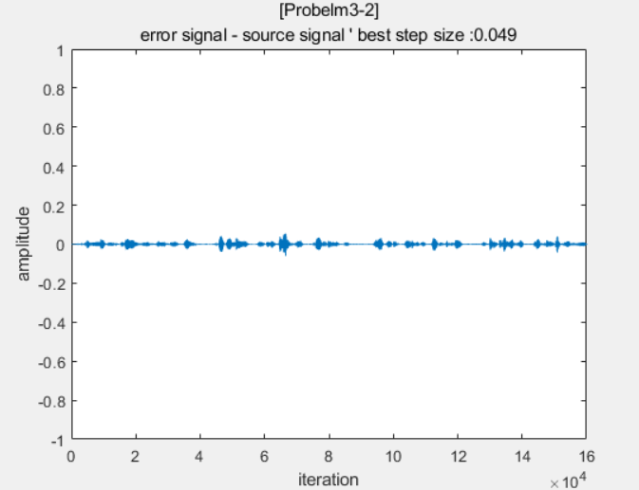
Least Mean Square Adaptive Filter
문제 3
1. LMS algorithm 구현.
f = “standp4m1_nhpf_512.wav” step size µ = 0.049
Signal source s(n)
Noise source u(n)
Fig .3-4 (u(n) : voice signal noise , µ : 0.049)
(a) Error signal(e(n), e(n)-s(n) for filter order 512 (b) Compare Filter coefficients for filter order 512

Slide 16
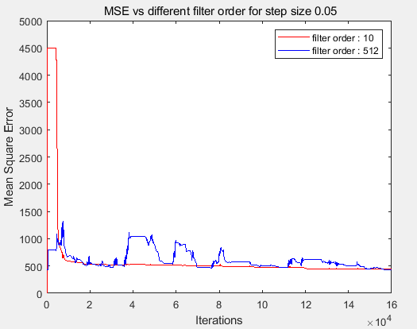
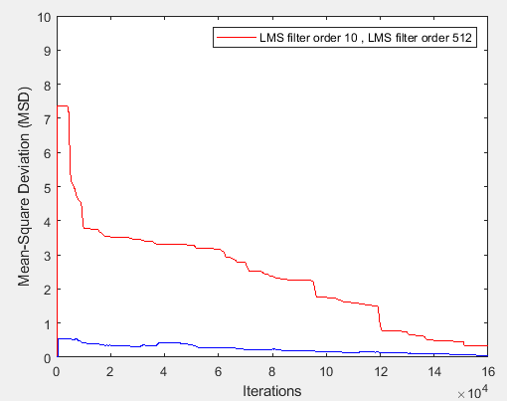
Least Mean Square Adaptive Filter
문제 3 (cf. 문제 2)
Fig .3-5 (u(n) : voice signal noise , µ : 0.05)
Performance Measure of LMS filter order 10, filter order 512 Convergence parameter µ
(a) Mean square value of the error signal (MSE) (b) Mean Square Deviation of the Tap weight vector

Slide 17
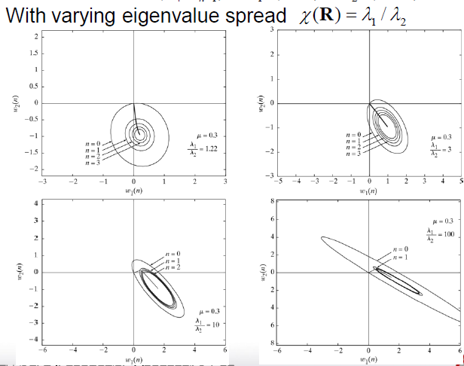
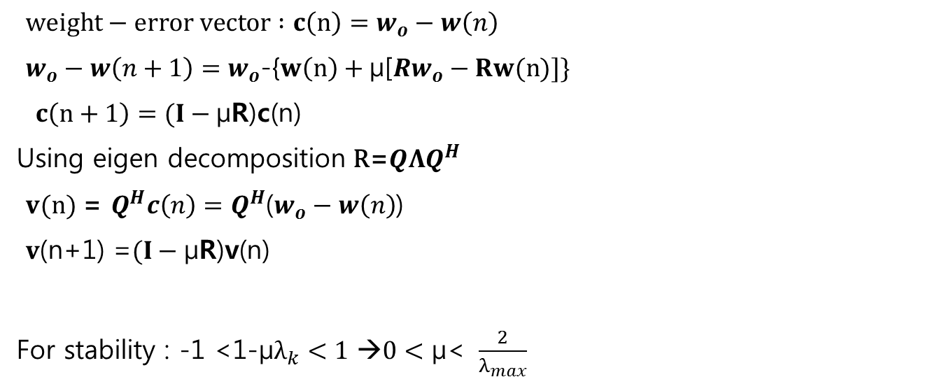

Normalized LMS Adaptive Filter
$weight−error vector :c\left(n\right)=w_{o}−w\left(n\right)$
$w_{o}−w\left(n+1\right)=w_{o}$-{$w\left(n\right)+\text{µ}\text{[}Rw_{o}−Rw(n)]\}$
$c\left(n+1\right)=(I−\text{µ}\text{R}\text{)}\text{c}\text{(}\text{n}\text{)}$
Using eigen decomposition $\text{R}\text{=}QΛQ^{H}$
$v\text{(}\text{n}\text{)} \text{=} Q^{H}c\left(n\right)=Q^{H}$($w_{o}−w\left(n\right)$)
$v$(n+1) =$(I−\text{µ}\text{R}\text{)}\text{v}\text{(}\text{n}\text{)}$
For stability : -1 <1-$\text{µ}λ_{k}<1$ →$0<\text{µ}\text{< }\frac{2}{λ_{max}}$
Eigen value spread가 크면, $\text{µ}$ 값이 줄어들어
stable한 $\text{µ}$범위가 준다.

Slide 18
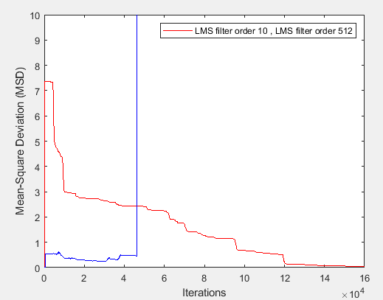
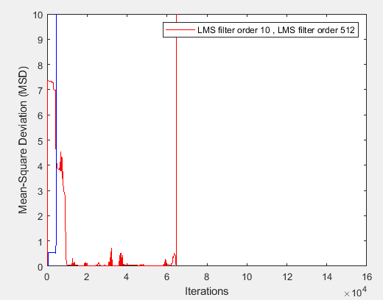
Least Mean Square Adaptive Filter
문제 3(Limitation of LMS, Divergence)
Fig .3-3 (u(n) : voice signal noise)
Performance Measure of LMS filter coefficients µ : 0.1, µ : 1.3 Convergence parameter for large µ
(a) Mean square value of the error signal (MSE) (b) Mean Square Deviation of the Tap weight vector

Slide 19
Matlab code
%% FIR filter parameters
b = [-0.4, -1.7, 0.1, 0.3, -1.1, 1.2, 1.2, 0.0, 0.3, 0.2];
a = [1];
reflect_u_1 = filter(b,a,u);
d_low = s + reflect_u_1; Desired input d(n)
%% y(n) = w*u(n) / mu = 0.05;
M = length(u); % input data length
N_low = length(b);
h_LMS_low = zeros(1,N_low); Initialize adaptive filter coefficients w = 0
for l = N_low : M
u1 = u(l :-1: l-N_low+1)'; vector containing M samples of the input signal.
y_temp_LMS_1 = h_LMS_low*u1';
e_temp_LMS_1 = d_low(l) - y_temp_LMS_1; Tap-weight update
h_LMS_low = h_LMS_low+mu*e_temp_LMS_1*u1;
end

Slide 20







Normalized LMS Adaptive Filter
LMS algorithm은 입력신호의 크기가 커지면 filter weights의 변화가 커지게 되어 cost function인 MSE가 발산하는 gradient noised amplification 문제가 있다.
Adaptive filter coefficient $\hat{w}$(n)를 update 한 후의 output signal $y\left(n\right)$이 desired response d(n)이 되기 위한
의 조건을 충족해야 한다.
Squared Euclidean norm 을 Cost function으로 사용하여 minimize 한다.
→ constraint가 있는 optimization 문제 → Lagrange multiplier 사용.
$$\left.{\hat{w}}^{H}\left(n+1\right)u\left(n\right)=d(n\right)$$
${\left\|δ\hat{w}\left(n+1\right)\right\|}^{2}={\left\|\hat{w}\left(n+1\right)−\hat{w}\left(n\right)\right\|}^{2}$
Let $\hat{w}\left(n+1\right)=a+jb$
$J\left(n\right)= {\left\|δ\hat{w}\left(n+1\right)\right\|}^{2}+Re[λ^{∗}\left(d\left(n\right)−{\hat{w}}^{H}\left(n+1\right)u\left(n\right)\right)]$
$=$ $\left({\hat{w}}^{H}\left(n+1\right)−{\hat{w}}^{H}\left(n\right)\right)\left(\hat{w}\left(n+1\right)−\hat{w}\left(n\right)\right)+{\frac{1}{2}[λ}^{∗}\left(d\left(n\right)−{\hat{w}}^{H}\left(n+1\right)u\left(n\right)\right)+λ\left(d^{∗}\left(n\right)−u^{H}(n)\hat{w}\left(n+1\right)\right)$
$$= \left(a−jb−{\hat{w}}^{H}\left(n\right)\right)\left(a+jb−\hat{w}\left(n\right)\right)+\frac{1}{2}{\left[λ\right.}^{∗}\left(d\left(n\right)−(a−jb)u\left(n\right)\right)+λ\left(\left.d^{∗}\left(n\right)−u^{H}(n)(a+jb\right)\right)$$
$$\frac{∂J\left(n\right)}{{\hat{w}}^{H}\left(n+1\right)}= \frac{∂J\left(n\right)}{∂a}+j\frac{∂J\left(n\right)}{∂b}= 0$$
$= \left(a+jb−\hat{w}\left(n\right)\right)+\left(a−jb−{\hat{w}}^{H}\left(n\right)\right)+j\left[−j\left(a+jb−\hat{w}\left(n\right)\right)\right]+j\left(a−jb−{\hat{w}}^{H}\left(n\right)\right)+\frac{1}{2}{[λ}^{∗}\left(−u\left(n\right)+λ{(−u}^{H}\left(n\right)\right)+j{\{λ}^{∗}\left(ju\left(n\right)\right)+λj(−u^{H}($n))}
$=2\left(a+jb−\hat{w}\left(n\right)\right)−λ^{∗}u(n)$
$$=2\left(\hat{w}\left(n+1\right)−\hat{w}\left(n\right)\right)−λ^{∗}u\left(n\right)=0$$

Slide 21




Normalized LMS Adaptive Filter
.
$d\left(n\right)= {\hat{w}}^{H}\left(n+1\right)u\left(n\right)={(\hat{w}\left(n\right)+{\frac{1}{2}λ}^{∗}u\left(n\right))}^{H}u\left(n\right)= {\hat{w}}^{H}\left(n\right)u\left(n\right)+\frac{1}{2}λ{\left\|\left.u(n\right)\right\|}^{2}$ → $λ= \frac{2e(n)}{{\left\|u(n)\right\|}^{2}}$
$$2\left(\hat{w}\left(n+1\right)−\hat{w}\left(n\right)\right)−λ^{∗}u\left(n\right)=0 \text{→} \hat{w}\left(n+1\right)= \hat{w}\left(n\right)+\frac{\tilde{μ}}{{\left\|u\left(n\right)\right\|}^{2}}u\left(n\right)e^{∗}(n)$$
$small norm {\left\|u(n) \right\|}^{2}$일 때를 피하기 위해 constant $δ≅1$을 추가한다.
$$\text{Tap} \text{weight} \text{adaptation} : \hat{w}\left(n+1\right)= \hat{w}\left(n\right)+\frac{\tilde{μ}}{{\left\|u\left(n\right)\right\|}^{2}+δ}u\left(n\right)e^{∗}(n)$$
Normalized LMS 에서는 Time-varying step-size parameter 이다.
(cf. LMS fixed step-size)
분자와 분모 모두 차수가 u(n)에 square로 dimension이 같다.
(dimensionless)
→ 입력신호 u(n)의 크기가 normalized 되어 들어오기때문에
noise에 의한 발산의 위험이 없다.
→ LMS에서는 $μ를$ 입력신호에 맞게 조정해야 하는 문제점이 있지만,
NLMS는 $\tilde{μ}$ 를 입력신호에 따라 조정할 필요 없다.
→ 입력신호가 normalized되어 변화폭이 작기때문에 convergence rate이 LMS 보다 빠르다.
$\hat{w}\left(n+1\right)=\hat{w}\left(n\right)+ \frac{\tilde{μ}}{ {\left\|u\left(n\right)\right\|}^{2}}u\left(n\right)e^{∗}\left(n\right)=\hat{w}\left(n\right)+ \frac{\tilde{μ}}{ {\left\|u\left(n\right)\right\|}^{2}}u\left(n\right)(d^{∗}\left(n\right)−wu^{H})$
Fig .4-1
Normalized Reference input $\frac{u(n)}{{\left\|u\left(n\right)\right\|}^{2}}$

Slide 22
Normalized Least Mean Square Adaptive Filter
문제 4
문제 3.
LMS algorithm을 normalized LMS algorithm으로 바꾸고 signal source s(n)으로 "FSJK1_con_160000_mul5.wav", noise source u(n)으로 "MDAC0_con_160000_mul5.wav", f로 "standp4m1_nhpf_512.wav"를 사용하여 e(n), e(n)-s(n)의 waveform을 그리고, f와 최종 w를 비교하라.
Fig .3-1
(a) Signal source s(n) (b)Reference input u(n) (c) Primary input d(n)

Slide 23




Normalized LMS Adaptive Filter
Signal source s(n)
Noise source u(n)
f = “standp4m1_nhpf_512.wav” step size µ = 0.05
Fig .4-1 (u(n) : voice signal noise , µ : 0.05)
(a) Error signal(e(n), e(n)-s(n) for filter order 512 (b) Compare Filter coefficients for filter order 512

Slide 24


Simulation Results P-4
Fig .4-2 (u(n) : voice signal noise , µ : 0.1)
Performance Measure of LMS, NLMS Convergence parameter
(a) Mean square value of the error signal (MSE) (b) Mean Square Deviation of the Tap weight vector

Slide 25
Matlab code
%% FIR filter parameters
[f,Fs3] = audioread('standp4m1_nhpf_512.wav');
reflect_u = filter(f,a,u);
d = s + reflect_u; Desired input d(n)
%% y(n) = w*u(n) / mu = 0.05;
M = length(u); % input data length
N = length(f);
h_NLMS = zeros(1,N); Initialize adaptive filter coefficients w = 0
for m = N : M
u1 = u(m :-1: m-N+1)'; vector containing M samples of the input signal.
y_temp_NLMS = h_NLMS*u1';
e_temp_NLMS = d(m) - y_temp_NLMS; Tap-weight update
h_NLMS= h_NLMS+mu/(u1*u1'+1.00526)*e_temp_NLMS*u1
end
Normalized u(n)

Slide 26




Block processing
Data → grouping in blocks of length L.
k: block index, L : block length
n = kL + i
the input signal : u(kL+i)
the output signal : y(kL+i) = ${\hat{w}}^{T}\left(k\right)u\left(kL+i\right)$
the error signal : e(kL+i)
Update equation
$\hat{w}\left(k+1\right)= \hat{w}(k)+μ\sum_{i=1}^{L−1}{u\left(kL+i\right)e(kL+i)}$
$donoting μ=μ_{B}/L$
$=\hat{w}\left(k+1\right)= \hat{w}\left(k\right)+μ_{B}\left[\frac{1}{L}\sum_{i=1}^{L−1}{u\left(kL+i\right)e\left(kL+i\right)}\right]$
$=\hat{w}\left(k\right)−μ_{B}\frac{1}{2}{\hat{∇}}_{w(k)}J$
Gradient vector
${\hat{∇}}_{w(k)}J= −\frac{2}{L}\sum_{i=1}^{L−1}{u\left(kL+i\right)e\left(kL+i\right)}$
LMS
Block LMS
여러개의 출력을 matrix 로 한번에 연산→ block마다 w update
Block length가 길면 더 정확한 값으로 수렴한다.

Slide 27






FFT processing
Discrete Fourier transform Inverse DFT
The operation of adding zeros (zero padding)
$$X^{d}[k]=\sum_{n=0}^{N−1}{x\left[n\right]W_{N}^{−nk} } W_{N}=e^{\frac{j2π}{N}} , 0≤k≤N−1$$
$$x\left[n\right]=\frac{1}{N}\sum_{k=0}^{M−1}{X^{d}[k]W_{N}^{nk} }$$
$$x_{a}\left[n\right]=x\left[n\right], 0≤n≤N−1$$
$$=0, N≤n≤M−1$$
$$X_{a}^{d}\left[k\right]=\sum_{n=0}^{M−1}{x_{a}\left[n\right]W_{M}^{−nk} }= \sum_{n=0}^{N−1}{x_{a}\left[n\right]W_{M}^{−nk} }$$

Slide 28

Fast Bock LMS Adaptive Filter
N –– Filter length L –– Block length μ –– Step size parameter
u(n) –– Input signal
U(k) –– Transformed input signal in the frequency domain
d(n) –– Desired signal
e(n) –– Error between the desired signal and the filter output
E(n) –– Transformed error signal in the frequency domain
W(k) –– Tap-weights vector in the frequency domain

Slide 29




Fast-Block LMS Adaptive Filter
Signal source s(n)
Noise source u(n)
f = “standp4m1_nhpf_512.wav” step size µ = 0.1
Adaptive Algorithm | N = 10 | N = 512
 | Time $mseg$ | Time $mseg$
LMS | 630 | 986
NLMS | 536 | 791
Fast Block LMS | 356 | 578
Table .2 Shows the Operation Time of the various Adaptive Algorithms
Fig .3-4 (u(n) : voice signal noise , µ : 0.1)
(a) Error signal(e(n), e(n)-s(n) for filter order 512 (b) Compare Filter coefficients for filter order 512

Slide 30









Matlab code
Insert Zero Block
%% Fast Block LMS algorithm
%number samples in each frame (block length)
L = 512;
N = length(f); % filter length
% MM = 2^10; % taps
%calculations of number of frames
Nframes = fix(M/L); % %calculations of number of frames
trials = 10;
w = zeros(L,1);
W = zeros(2*L,1); %M
M = length(u); % input data length
P = 0;
alpha = 0.05;
gamma= 0.9;
e = d;
% insert zero block
Evec=fft([zeros(L,1);e(i*L+1:(i+1)*L)], 2*L);
% estimated power / nonstationary environments(voice signal noise)
P = gamma*P + (1-gamma)*abs(Uvec).^2;
% block k, inverse of power
Dvec = 1./P;
%estimated gradient
g = ifft(Dvec.*conj(Uvec).*Evec,2*L);
% Delete last block
g = g(1:L);
% Append zero block
g = fft([g;zeros(L,1)], 2*L);
% update of weights
W = W+alpha*g;
end
w=ifft(W);
w=real(w(1:length(W)/2));
e = real(e(:));
error = e-s;
0 | new
$$Gradient constraint$$
$$2M length FFT$$
Delete Last Block
$$\hat{∇}$$ | / /
Append Zero Block
$$\hat{∇}$$ | 0
for i = 1 : Nframes -1
if i == 0
Uvec = fft([zeros(L-1,1);u(1:L)],2*L);
% block k-1, k; transformed input signal U(k)
else
Uvec =fft([u((i-1)*L+1:(i+1)*L)],2*L );
end
% block k, output signal y(k), last M elements
yvec = ifft(Uvec.*W);
% save last block
yvec = yvec(L+1 : 2*L,1);
% block k; desired signal
dvec = d(i*L+1:(i+1)*L);
% block k, error signal
e(i*L+1:(i+1)*L,1) = dvec-yvec;
e_FFTLMS = e;
% transformation of estimation error
$$Concatenate Two blocks, each FFT :2L points$$
old | new
$$Save last blok$$
discard | yvec

